Slide 1

CSCI 4237
Software Design for Handheld Devices
Lecture 1 - Course Intro
Mike Cobb

Slide 2
Who am I? Retired Army (Communications/Automation) IT Director 10 years Professor/Adjunct Professor USMA, GMU, WUST Cyber, IT

Slide 3
What do I do?
Defense Acquisition University
Offensive Cybersecurity courses
Software Development
Military Vehicle Simulation
Lead for NDAA response to Congress

Slide 4
What are we doing today?
Syllabus Review
Introductions
Why Android?
Git/GitHub
Android Studio
Kotlin
In-class exercises

Slide 5
Introductions
Name (what you want me to call you)
Favorite Mobile App
Something interesting about you

Slide 6
Course Syllabus

Slide 7
CSCI 4237
Pre-reqs:
CSCI 2113 (Software Engineering).
Comfortable with Java / OOP.
Basic understanding of Git.
A computer capable of running Android Studio and, ideally, the Android Emulator.

Slide 8

GitHub
Our GitHub org:

Slide 9
Let’s set some expectations...
I’ll be teaching Android development using Kotlin.
We’ll use GitHub for projects
Pull requests / code reviews / code structure / architecture / etc.
Communications
Email: Michael.cobb@email.gwu.edu
Text: 540.834.9569
Voice call but I may not be able to answer during the day or Monday nights

Slide 10
Class Format
Some Lecture
Use hands on exercises in class
Homework

Slide 11
Disclaimers
This is a once-a-week class... at 2.5 hrs per lecture
Class is Synchronized in-person course
My expectation is you will come to class and participate each week
Weather may change plans

Slide 12
Materials
Android developers website: https://developer.android.com/guide/
Google also hosts free developer tutorials & codelabs: https://codelabs.developers.google.com/android-training/ https://codelabs.developers.google.com/android-kotlin-fundamentals/

Slide 13
Materials
No textbook required, but if you’d like a hard copy:
Kotlin in Action
The code examples in the book are actually hosted online too.
Android Programming: The Big Nerd Ranch Guide
Kotlin Programming: The Big Nerd Ranch Guide

Slide 14
Materials
You don’t strictly need an Android device for this course.
The Android emulator works fairly well and you can have different sizes, models, simulate location, simulate camera, etc.
However, I would recommend getting a physical device if you don’t already have one.
It’s a nice experience testing on a real device, with “real” data / conditions.
You can find devices under $100 that will be suitable.
Must be Android 6.0 (Marshmallow) or higher, to use with this class.
You do not need to buy a cellular plan / SIM card.

Slide 15
Materials
If your computer is not adequate enough to run the emulator smoothly enough for normal development, you will have to then purchase a physical device to use.
System Requirements

Slide 16
Grading Structure
Standard A-F scale, no +/-.
Breakdown:
15% Classwork and Homework
10% Quizzes
4 total, 2.5% each
15% Final Exam
30% Project 1
30% Project 2

Slide 17
Grading Structure
Homework/Classwork
Weekly report turned into Blackboard
Code and check-ins to GitHub

Slide 18
Grading Structure
Quizzes
Will be announced at least a week in advance.
Open-ended questions / short answer / fill-in-the-blank / etc.
Will be open-note / slides.

Slide 19
Projects
Project 1
TBD- Same project for everyone
Will have multiple check-in submissions.
Individual.
Project 2
Come up with your own idea, get it approved & scoped by me.
Loose constraints (e.g. “must have networking”).
Will have multiple check-in submissions.
Will have a final presentation / demo.
Individual

Slide 20
Grading Structure
Projects
I will give you a rubric for each project which includes the grading breakdown and my testing plan.
Forms the bulk of your grade - they can take a decent amount of time & coding; deliverables are spaced out to account for ~1 month of total time.

Slide 21
Late Policy
I will allow late work on homework & projects, up to 2 days late, with a penalty of 10% per day.
Quizzes / exams cannot be done late, unless prearranged.
Friday | Saturday | Sunday | Monday | Tuesday
Max 100% | Max 90% | Max 80% | 0% Assigned | 0% Assigned
Due Date | 1 Day Late | 2 Days Late | > 2 Days Late | > 2 Days Late

Slide 22
Office Hours
By appointment works best

Slide 23
Schedule
Tentative schedule of topics is in the syllabus, also includes due dates for assignments.
We will have an exam on the scheduled final exam day.

Slide 24
Student Expectations
For coding assignments, it’s okay to:
Learn from Android dev guides, YouTube, StackOverflow.
Cite small usages in comments.
Majority of code submitted must be original.
Keep in mind that Android changes frequently. It’s a very dynamic platform!
Use a library that has some functionality you need.

Slide 25
Student Expectations
Coding projects will be submitted via GitHub. I will be reviewing and providing feedback on:
Code style & organization.
Usage of comments / documentation.
Commit messages.
Any unique problem solving / creative usage of Kotlin. :)
Pull requests will be used to allow me to leave comments.
HW, Projects, and in-class exercises will have a Blackboard submission.

Slide 26
Plagiarism
I’m highly aware my past assignments are on GitHub - in fact, I’ve encouraged students to upload their projects!
I actively review source code as a part of grading, thru Pull Requests that you are required to submit.
I have yet to have a semester where plagiarism of another student’s work or online resource has not been a problem :(

Slide 27
Why Android?

Slide 28
Well, first… why mobile?
Nearly everyone has a smartphone.
You can control the full project -- the idea, UI designs, frontend, backend (if needed), etc.
Don’t need much extra technical knowledge to get started.
Lots of industry demand.
$$$?
Notes:
http://www.businessofapps.com/data/app-statistics/
https://www.kickassfacts.com/20-interesting-facts-about-android/

Slide 29
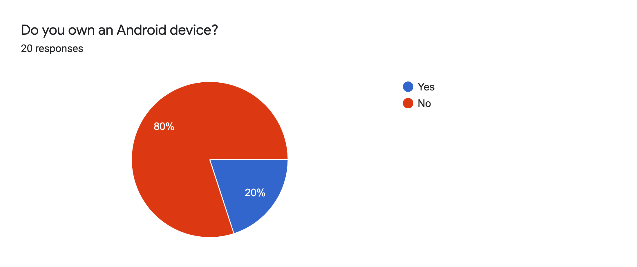
Market Share - This Class (Last Semester)
Notes:
http://gs.statcounter.com/os-market-share/mobile

Slide 30
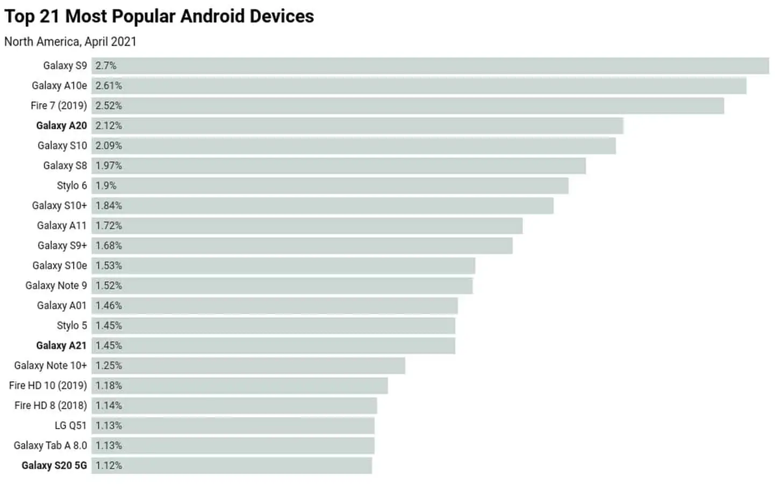
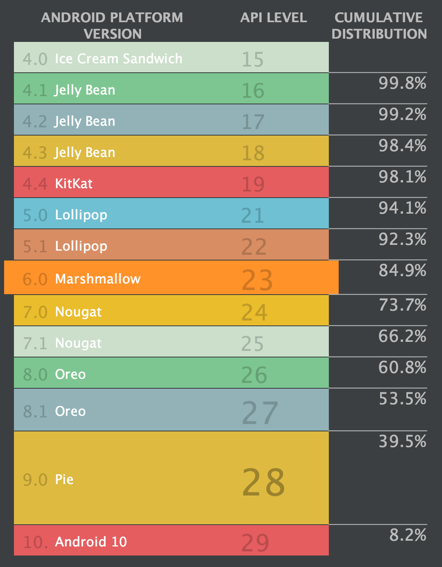
Device Fragmentation
Notes:
OpenSignal

Slide 31
As a Developer
iOS
Need to use Xcode -- only on OS X.
$99/year license to publish.
Strict App Store requirements to get published.
https://developer.apple.com/app-store/review/rejections/
But, revenue from the App Store is generally higher than Google Play.
Less device fragmentation makes development easier.

Slide 32
As a Developer
Android
Android Studio -- runs on Windows, Mac, Linux.
$25 one time fee to publish.
No formal review, also multiple app stores (e.g. Amazon) - good comparison.
More device fragmentation makes development & testing harder.

Slide 33
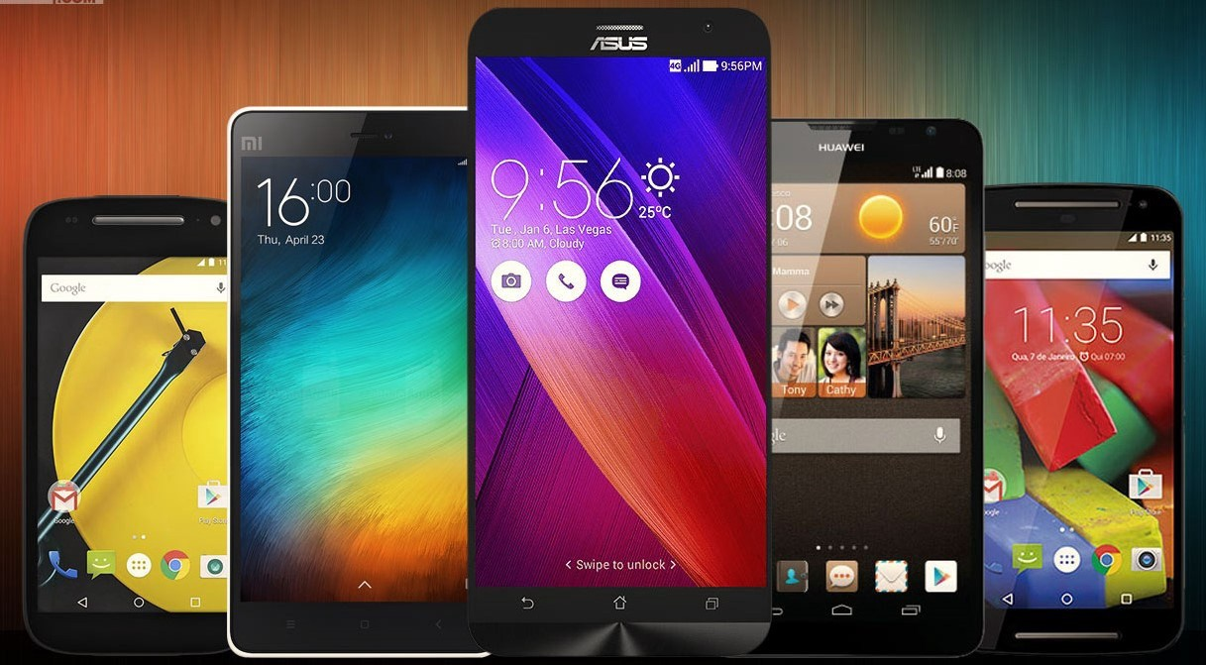
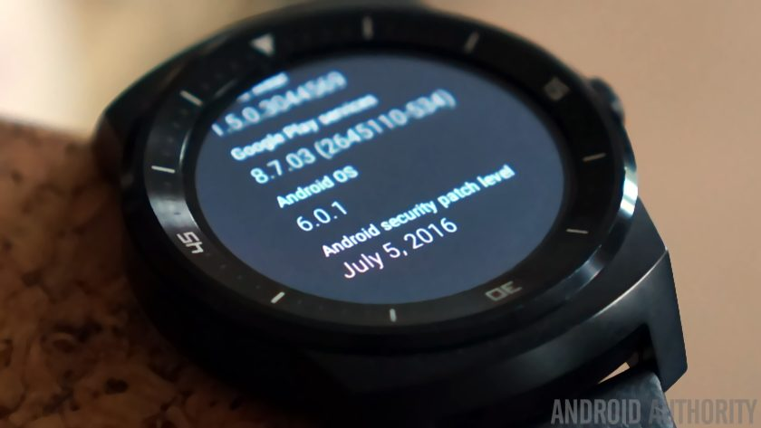
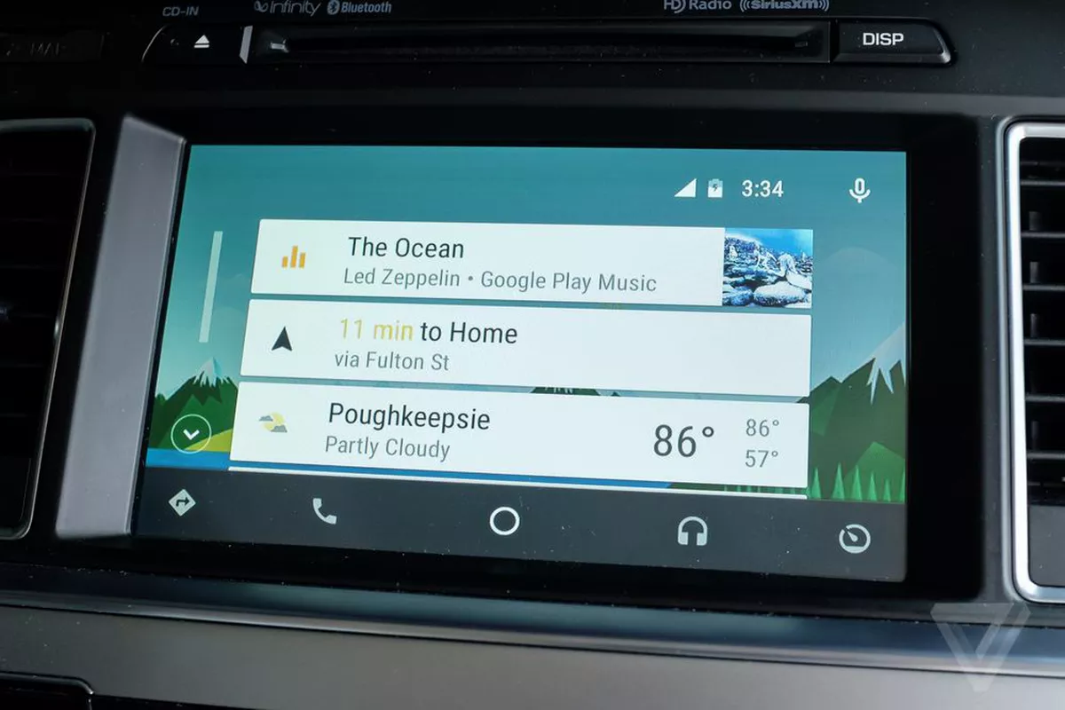
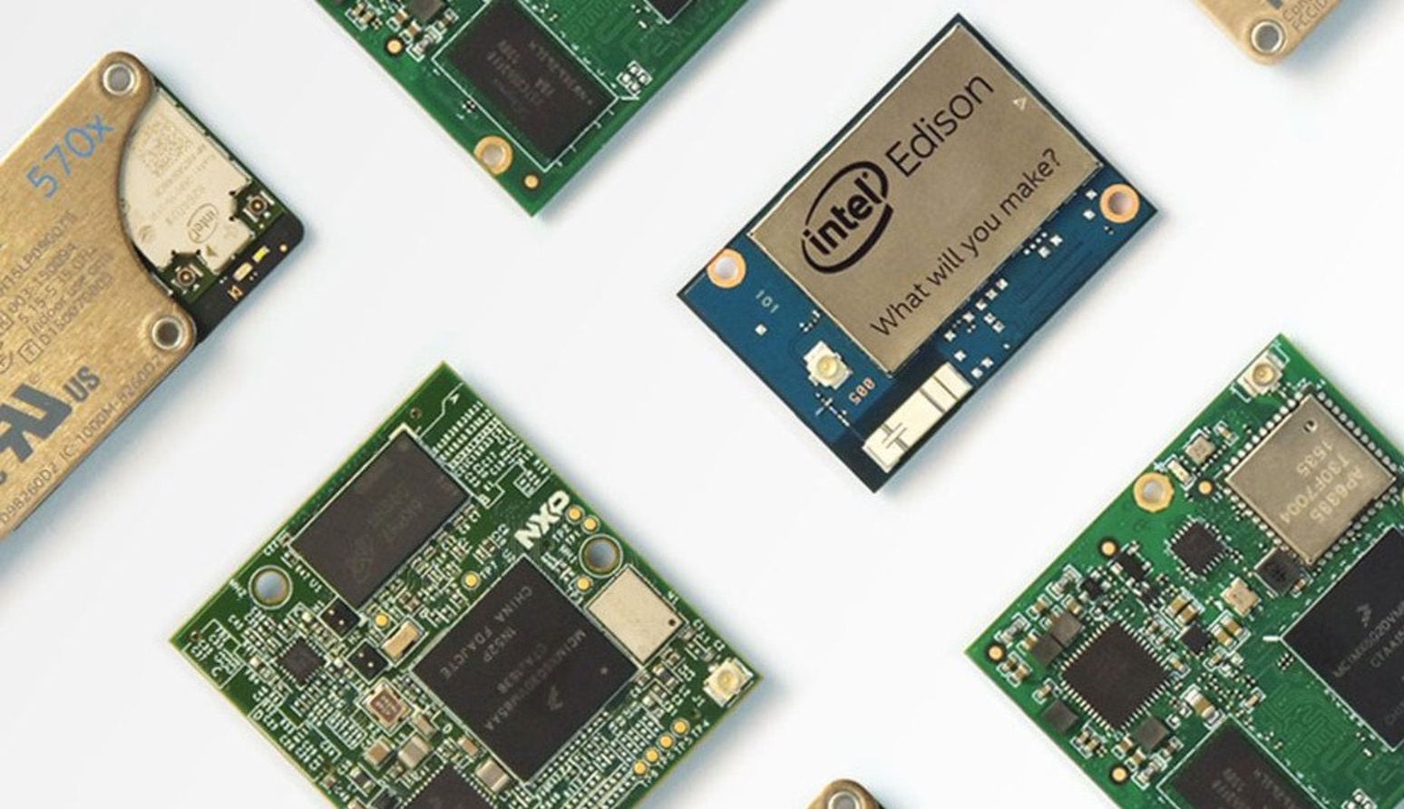

What else is cool about Android?
Multi-platform
In more than one way...

Slide 34



What else is cool about Android?
Multi-platform
Programming language
Though Kotlin is now the preferred language for Android.

Slide 35
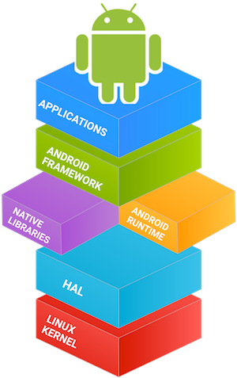
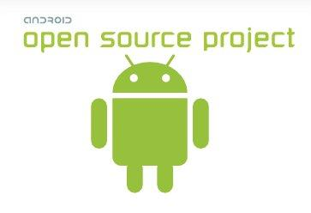
What else is cool about Android?
Multi-platform
Programming language
Open-source

Slide 36
Android Development

Slide 37



Our Main Tools
Android Studio
Gradle build system
GitHub
Version control
Kotlin

Slide 38
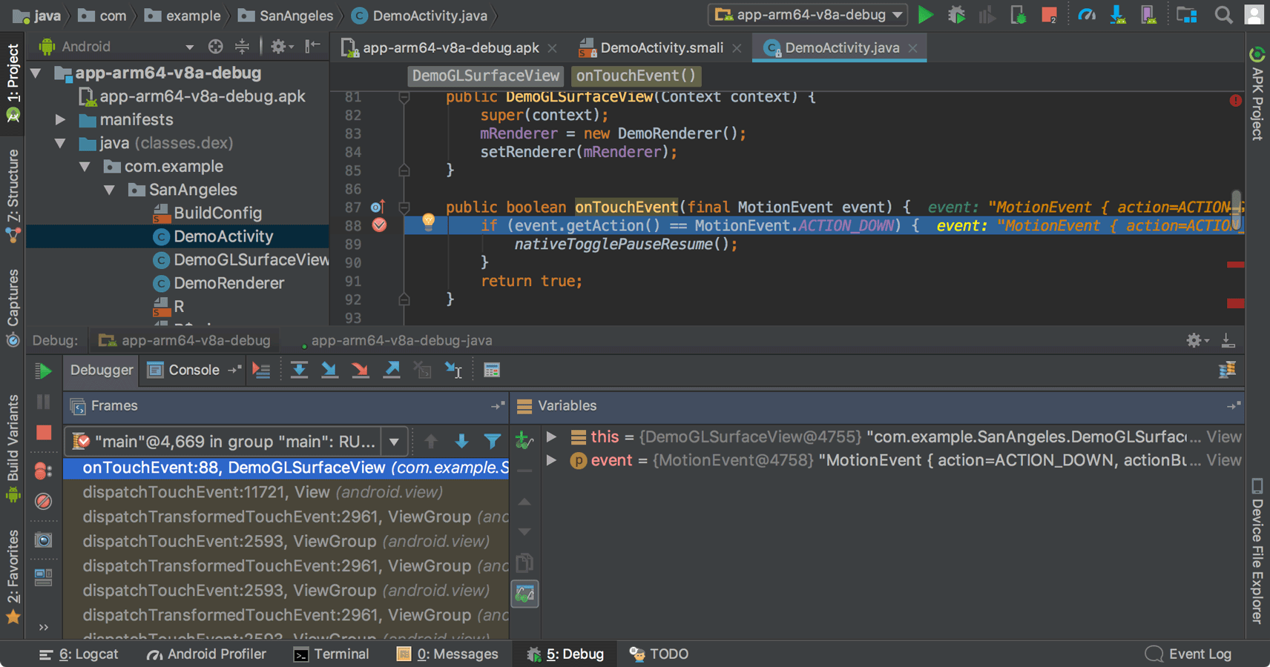
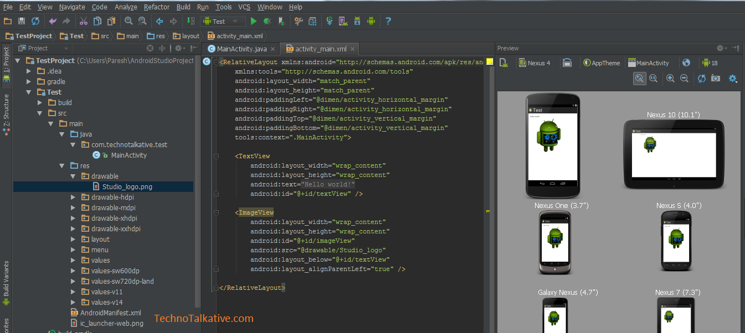
Android Studio
Fork of IntelliJ with Android support:
SDK Manager
Emulator
Debugging
UI Design

Slide 39

Kotlin
Runs on the JVM and is interoperable with Java.
Multiplatform.
Improves upon the shortcomings of Java -- less verbose, enforced nullability, and enforced mutability.

Slide 40
Kotlin
Android - previously limited to Java 7.
Kotlin support for:
Lambdas
Named / default parameters
Collection operators
Enforced nullability and mutability
Overall, less verbose

Slide 41
Kotlin
The main Kotlin docs are the primary resource: https://kotlinlang.org/docs/reference/
Key topics for today:
Basic Syntax

Slide 42
Kotlin
Let’s try some Kotlin online:
https://play.kotlinlang.org/

Slide 43
Kotlin - Shorter Syntax
// You don't need to specify the type if it can be implied
val number = 5
// ... but there’s no harm in doing so
val myString: String = "hello"

Slide 44
Kotlin - Shorter Syntax
// Function with params and return type
fun sum(a: Int, b: Int): Int {
return a + b
}
// Special short form for 1-line functions
fun sum(a: Int, b: Int) = a + b

Slide 45
Kotlin - Shorter Syntax
// In Kotlin “Void” == “Unit” and is the default
fun foo(): Unit {
// ...
}
// ...so you don’t need to specify it (for void functions)
fun bar() {
// ...
}

Slide 46
Kotlin - Shorter Syntax
// In Kotlin “Void” == “Unit” and is the default
fun foo(): Unit {
// ...
}
// ...so you don’t need to specify it (for void functions)
fun bar() {
// ...
}
// Example of returning a value (return type == Int)
fun baz(): Int {
// ...
return 6
}

Slide 47
Kotlin - Immutability
// val == you can't change the value later (final)
val number = 5
// var == you *can* change the value later
var string = "hello"
// Function
fun callMe() {
// The line below is not allowed, compiler error:
// number = 6
string = "Hello World!"
}

Slide 48
Kotlin - Immutability
// Also works for lists via typing List or MutableList!
// listOf(...) and mutableListOf(...) provide quick ways to
// initialize lists
val listOfStrings: List<String> = listOf("hello", "world")
val listOfNumbers: MutableList<Int> = mutableListOf(1, 2, 3)
fun callMe() {
// Compiler error since this is an immutable list
// listOfStrings.add("!")
// Allowed because this list is a mutable list
listOfNumbers.add(4)
}

Slide 49
Kotlin - Immutability
val listOfStrings: List<String> = listOf("hello", "world")
val listOfNumbers: MutableList<Int> = mutableListOf(1, 2, 3)
fun callMe() {
// But note that you can't *reassign either* variable,
// since they are val
// listOfStrings = listOf("a", "b", "c")
// listOfNumbers = mutableListOf(5, 6, 7, 8)
}

Slide 50
Kotlin - Nullability
// Types which can be assigned null are marked with a
// question mark after the type
var thisCanBeNullString: String? = null
var thisCanNotBeNullString: String = "hello"
fun callMe() {
// Allowable (also note that it is a "var")
thisCanBeNullString = null
// Compiler error
// thisCanNotBeNullString = null
}

Slide 51
Homework 1 - Part 1 - Install Programs
Install:
Android Studio: https://developer.android.com/studio/install
Git (and a UI program, if desired): https://git-scm.com/downloads

Slide 52
Creating a new Android Project

Slide 53
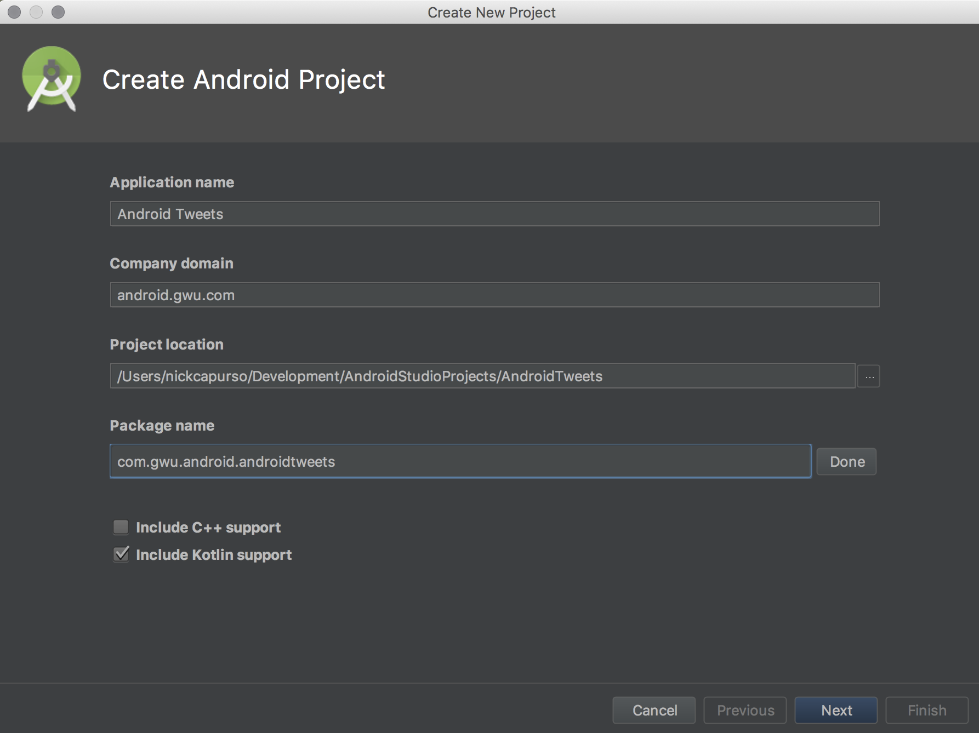

Slide 54
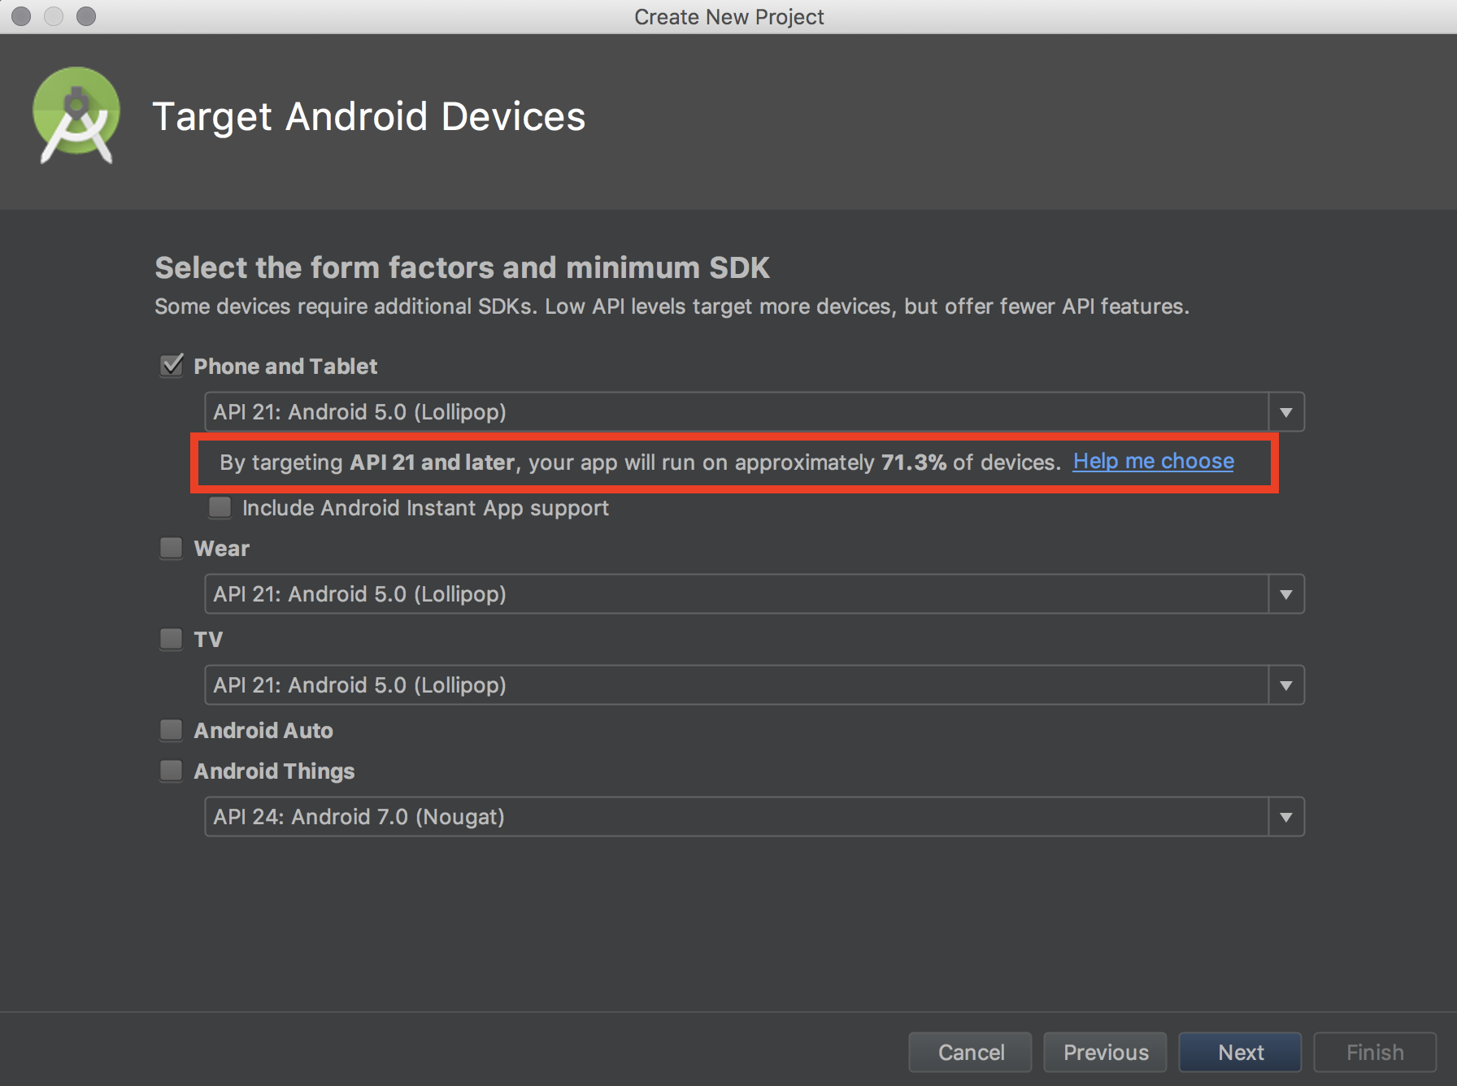

Slide 55
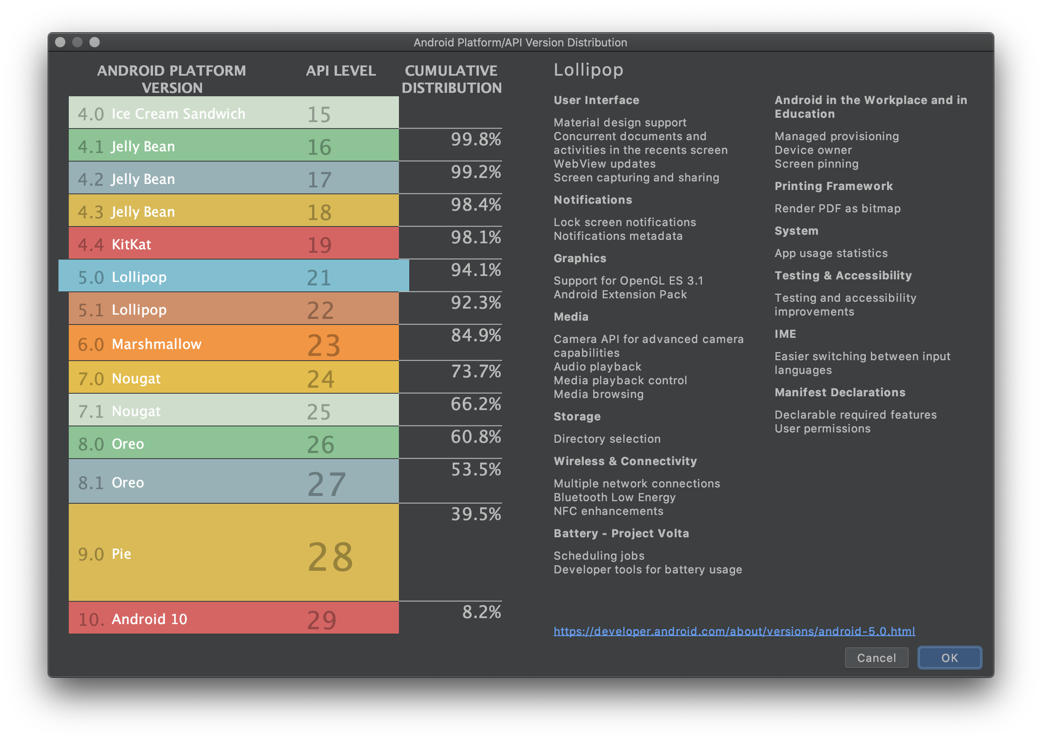

Slide 56
Choosing a minimum SDK
Factors:
Device availability (supporting older devices = more users).
Feature availability (not all functionality was available on older devices).

Slide 57
Choosing a minimum SDK
Factors:
Device availability (supporting older devices = more users).
Feature availability (not all functionality was available on older devices).
Generally, API 23 (Android 6.0) is becoming a popular baseline for a lot of apps (when Android introduced Permissions).
https://twitter.com/minsdkversion

Slide 58
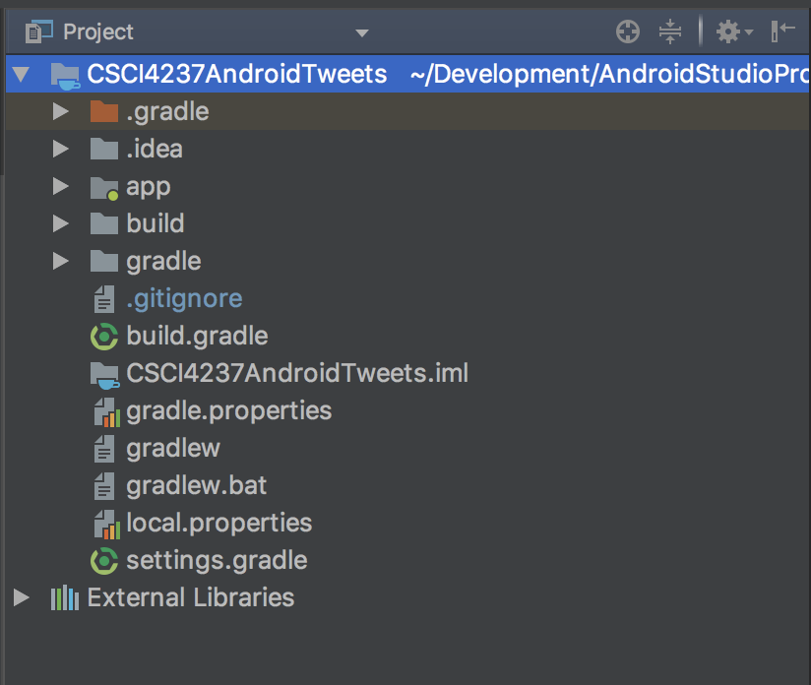
Project View
By default your view of the project is the “Android” view.
The “Project” view shows the complete file system’s structure.

Slide 59
Project View
Things of interest:
app - a code module which will contain the code for our app.
*.gradle - build scripts, we’ll look at these later.

Slide 60
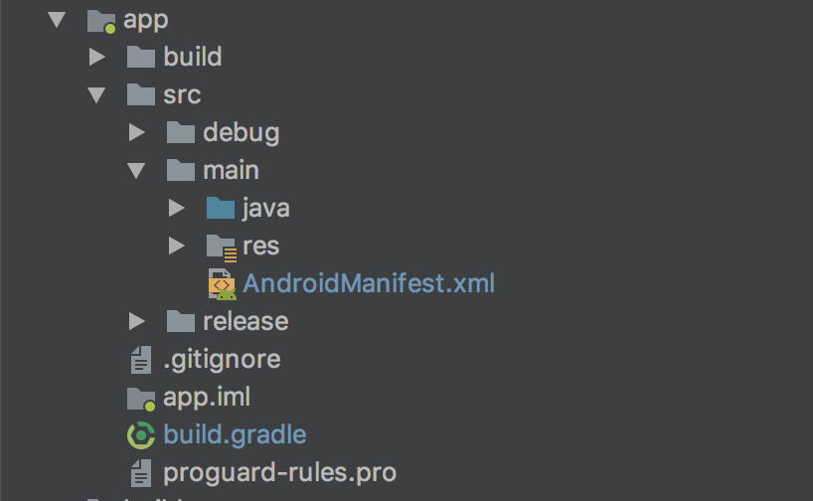
Project View
Things of interest:
src/main/java - contains all of our Java (and Kotlin) source code.
src/main/res - resources (images, sounds, strings, etc.)

Slide 61
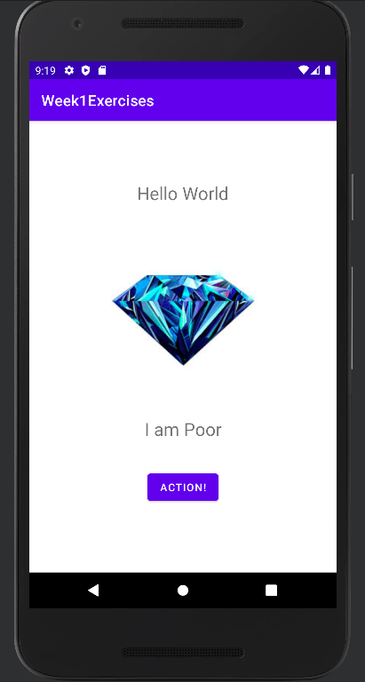
Activities
At a high level, Android apps are comprised of “Activities”.
An easy way to think about it is one screen == one Activity*
Notes:
*It doesn’t have to be, there’s a big push for Fragments, where one Activity is comprised of multiple fragments. However, they are tricky to learn & work with and you can build an entire app without using them at all. https://developer.android.com/guide/components/fragments

Slide 62
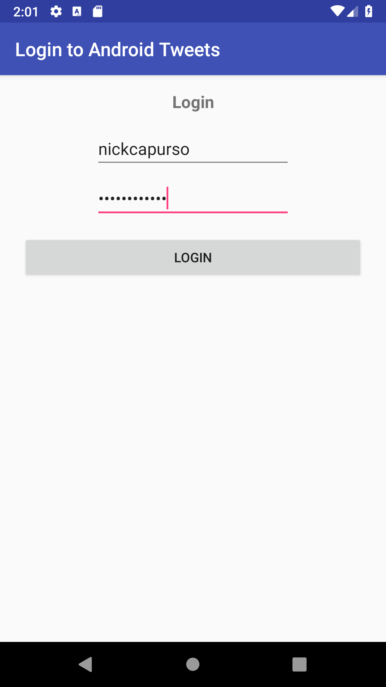
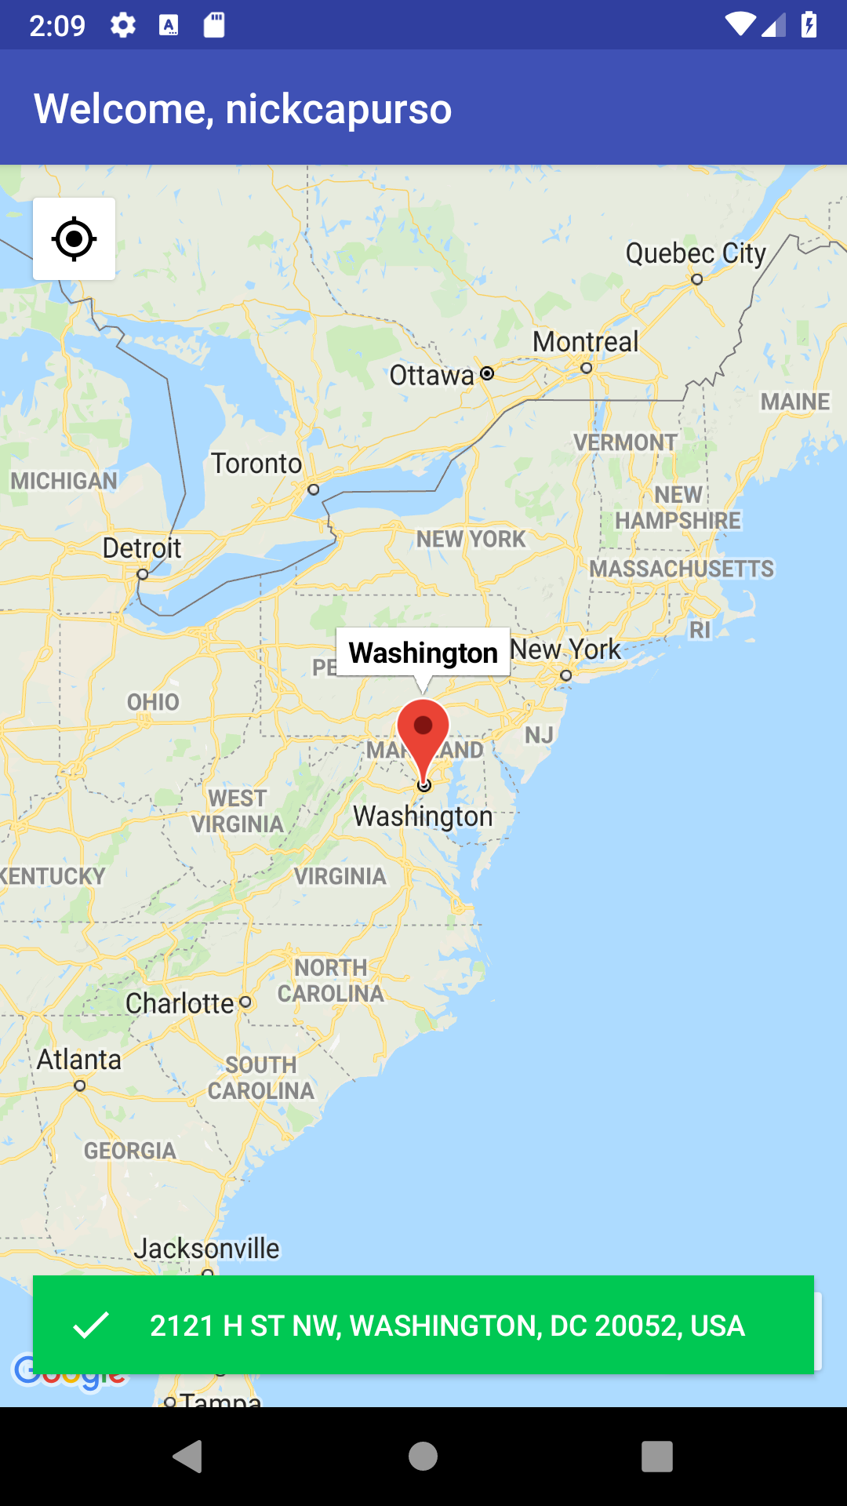
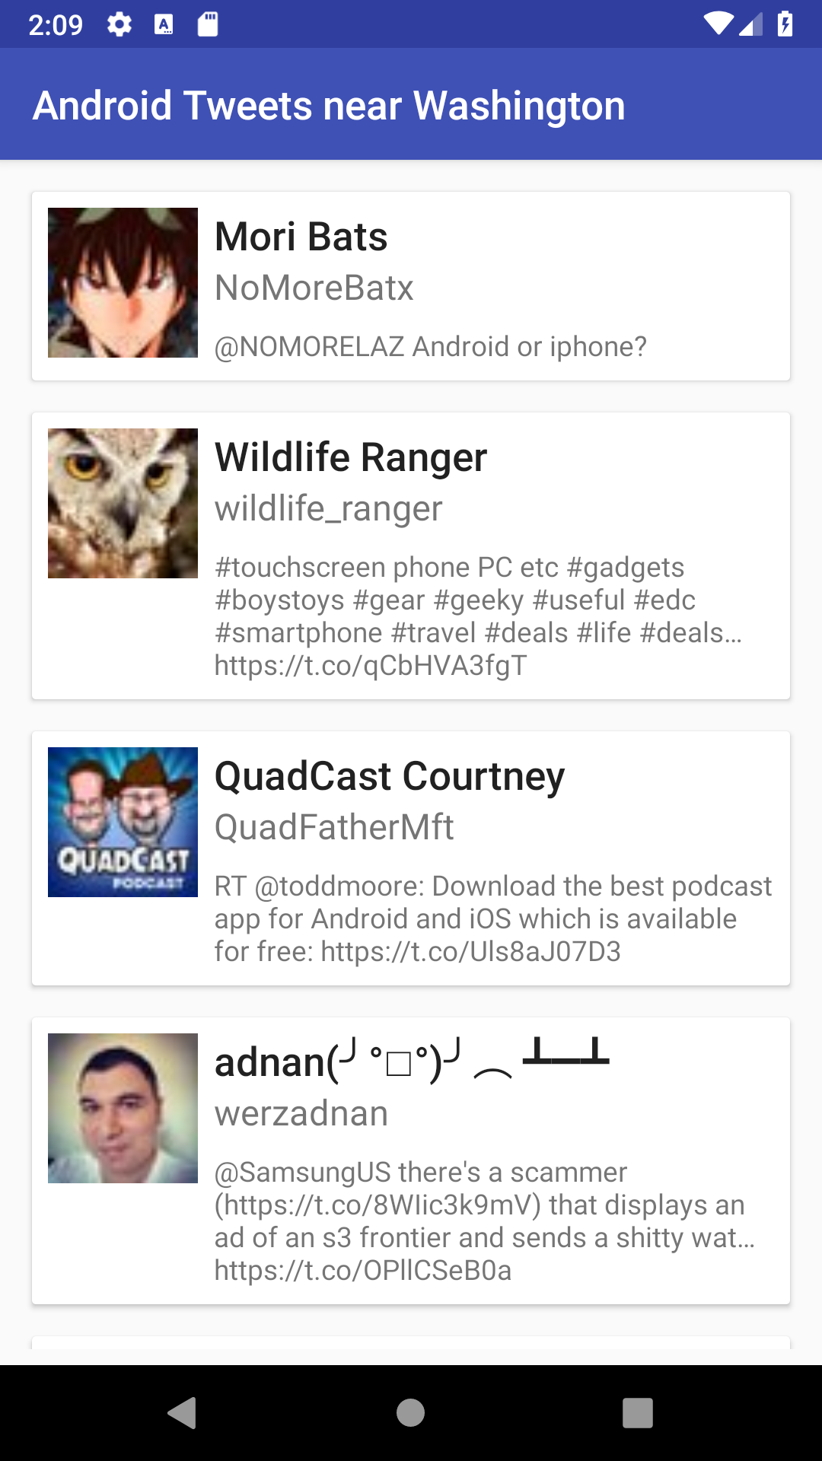
Activities
LoginActivity
LocationActivity
TweetsActivity

Slide 63
Main Activity
Ultimately, need to build:
The UI
A title, two text fields, a button, and an image(initially hidden)
The behaviors
Image is hidden initially
2d text view is I am rich
Button click shows diamond and changes message to I am poor

Slide 64
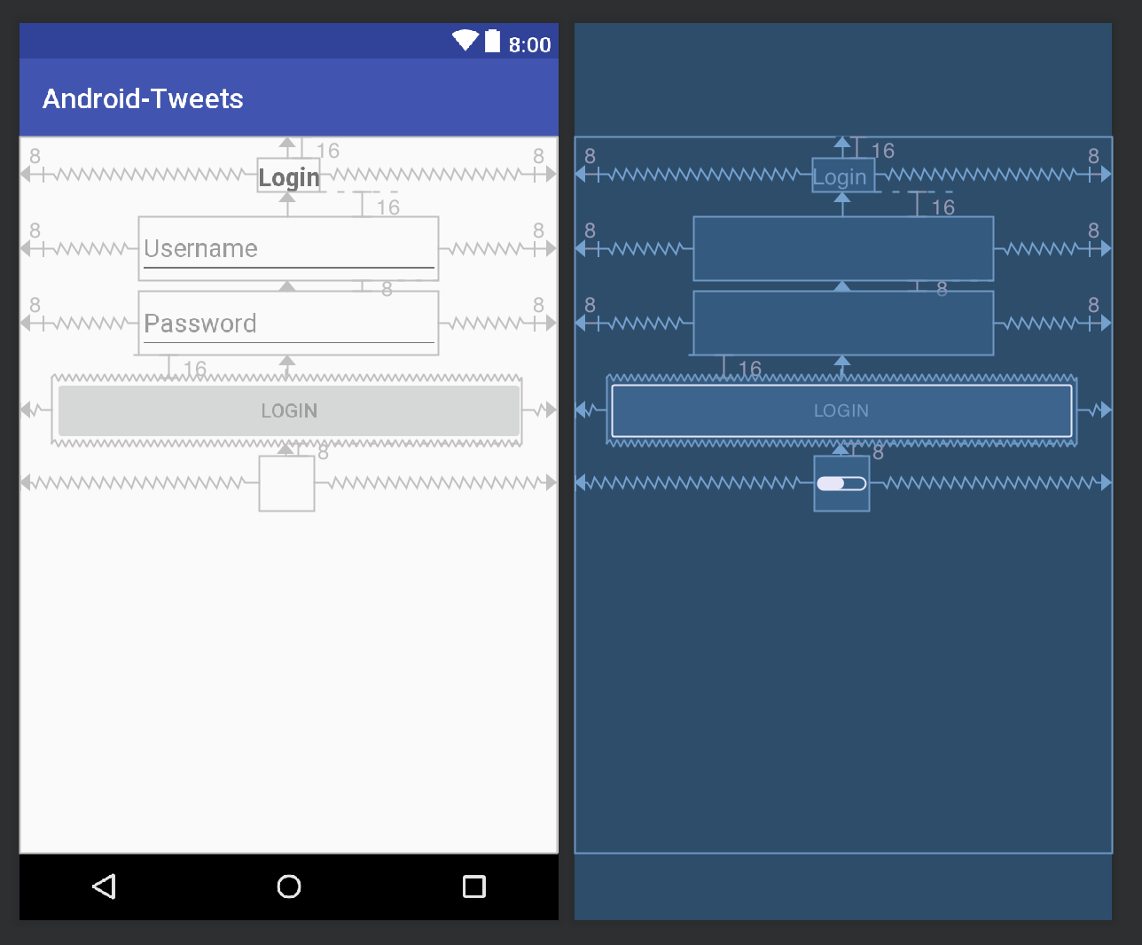
UI Design
In Android, the UI is designed using XML*.
Notes:
Both Android & iOS are alpha testing a new UI ToolKit where the screens are designed in code using composable function calls - similar to React Native.
https://developer.android.com/jetpack/compose

Slide 65
UI Design
In Android, the UI is designed using XML*.
Individual design components are called Views or Widgets. They are put in a Layout which determines placement on the screen.
Notes:
Both Android & iOS are alpha testing a new UI ToolKit where the screens are designed in code using composable function calls - similar to React Native.
https://developer.android.com/jetpack/compose

Slide 66
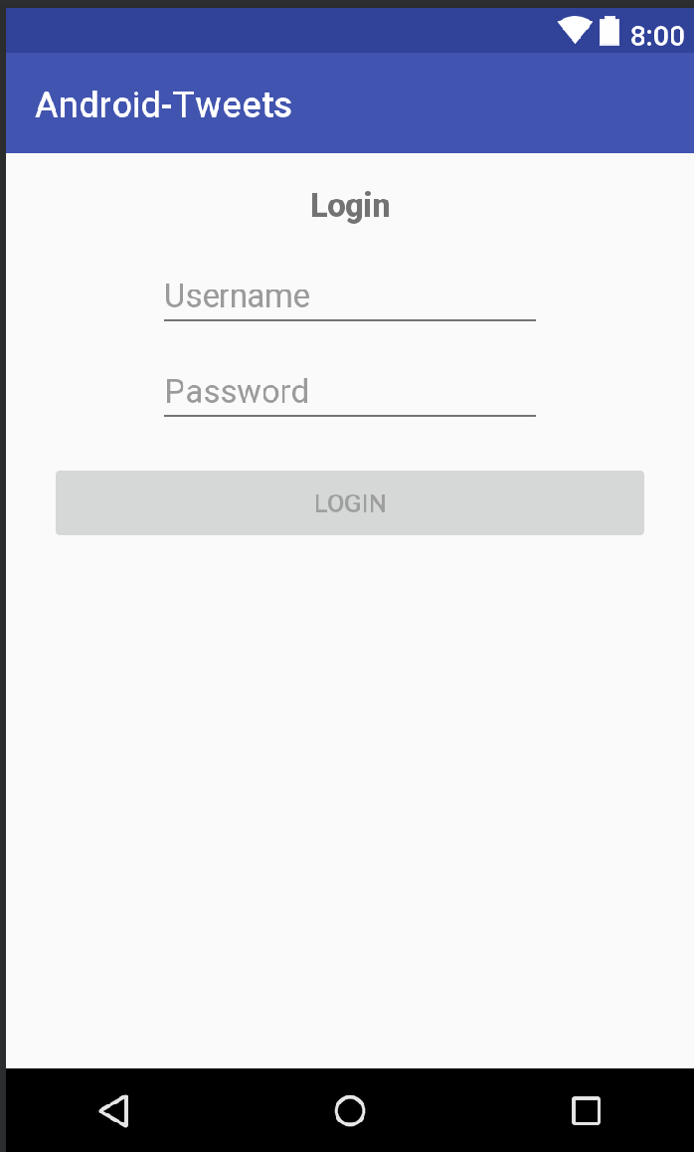
Layouts - LinearLayout
Can be horizontal or vertical and views are distributed accordingly.

Slide 67
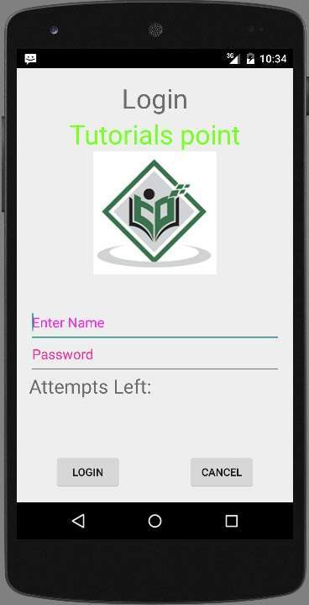
Layouts - LinearLayout
You may have to nest them to get a desired effect…
Building complex UIs can get messy with nesting.
Notes:
https://www.tutorialspoint.com/android/android_login_screen.htm

Slide 68
Layouts - RelativeLayout
You define relations between views.
“Login” title is anchored to the top of the screen.
“Cancel” is placed to the right of the “Login” button.
etc.

Slide 69
Layouts - RelativeLayout
Inefficient.
With a LinearLayout the system can place all the views in one pass (assuming no nesting).

Slide 70
Layouts - RelativeLayout
Inefficient.
With a LinearLayout the system can place all the views in one pass (assuming no nesting).
With a RelativeLayout the system may need multiple passes to fully render the screen (e.g. placing one view may affect other related views)

Slide 71
Layouts - ConstraintLayout
Newest layout.
Similar to RelativeLayout, but designed to minimize number of passes system needs to render your UI (efficient).
Also enables some new features (like guidelines).
Notes:
Also adds some features not present in RelativeLayout (e.g bias, guidelines, etc.)

Slide 72
Layouts - ConstraintLayout
You specify constraints:
The “title” should be constrained to the top of the screen and constrained halfway between the two sides.

Slide 73
Layouts - ConstraintLayout
Can use guidelines.
The “login” button should take up the space between the two guidelines.
The “login” button’s top should be constrained to the bottom of the “Password” field.

Slide 74
Login Activity
Your go-to layouts should mainly be between a LinearLayout or a ConstraintLayout.
Depends on UI complexity.

Slide 75
Login Activity
Let’s try designing the login screen using a ConstraintLayout.
We’ll use both the visual editor as well as manually writing XML.

Slide 76
Login Activity
I also have step-by-step instructions for building a basic login screen here: https://github.com/nickcapurso/SE-Summit-Android-Workshop/tree/master/instructions/2%20-%20Login%20UI

Slide 77
Login Activity
I also have step-by-step instructions for building a basic login screen here: https://github.com/nickcapurso/SE-Summit-Android-Workshop/tree/master/instructions/2%20-%20Login%20UI
It’s for a Android workshop I used to teach, so the screen built is slightly different.
We’ll go into more depth in this course as opposed to what I teach in a workshop setting.

Slide 78
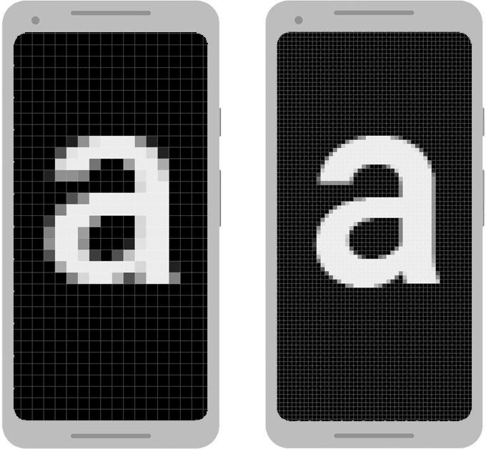
Understanding Dimensions
On Android, we don’t measure in pixels.
Two screens of the same size can have different densities.
Android provides “dp” or density-independent pixels as a measure.

Slide 79
Understanding Dimensions
Devices are categorized into “buckets” based on their screen density (dpi):
ldpi
mdpi
hdpi
xhdpi
…
mdpi is the baseline for dp

Slide 80
Understanding Dimensions
A Google Pixel 4 is an xxhdpi device, for example.

Slide 81
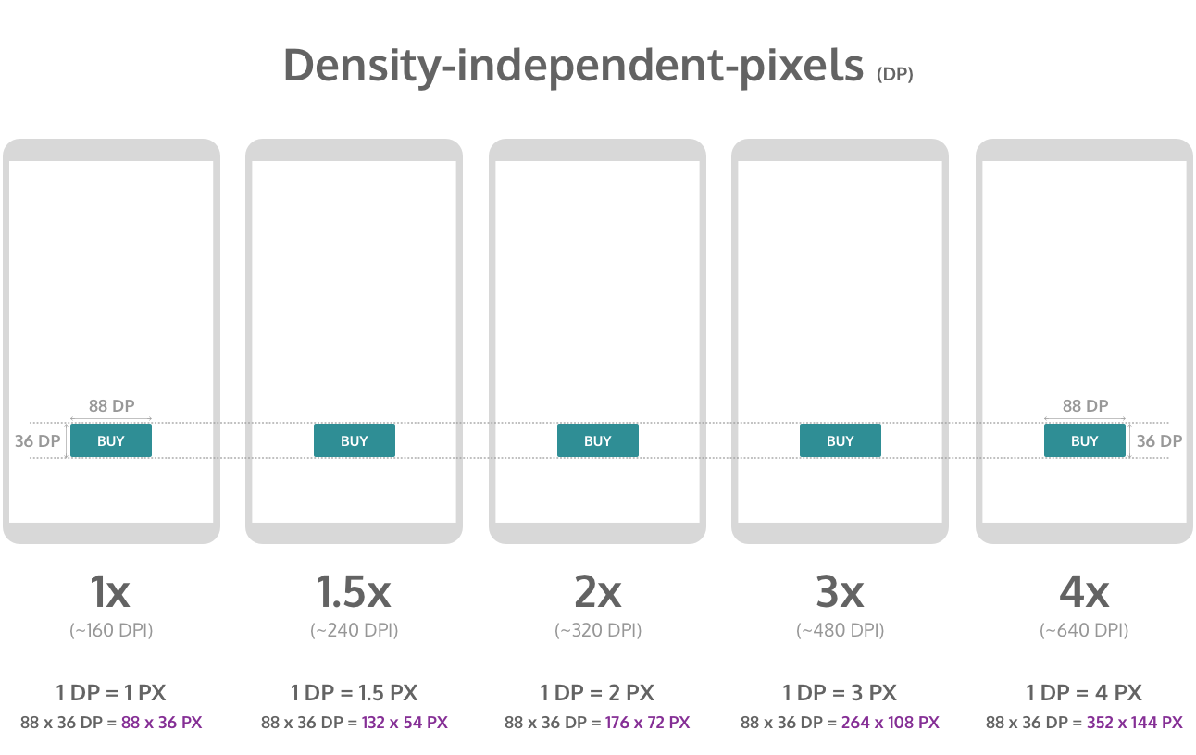
Understanding Dimensions
Notes:
https://blog.prototypr.io/designing-for-multiple-screen-densities-on-android-5fba8afe7ead
https://stackoverflow.com/questions/2025282/what-is-the-difference-between-px-dip-dp-and-sp

Slide 82
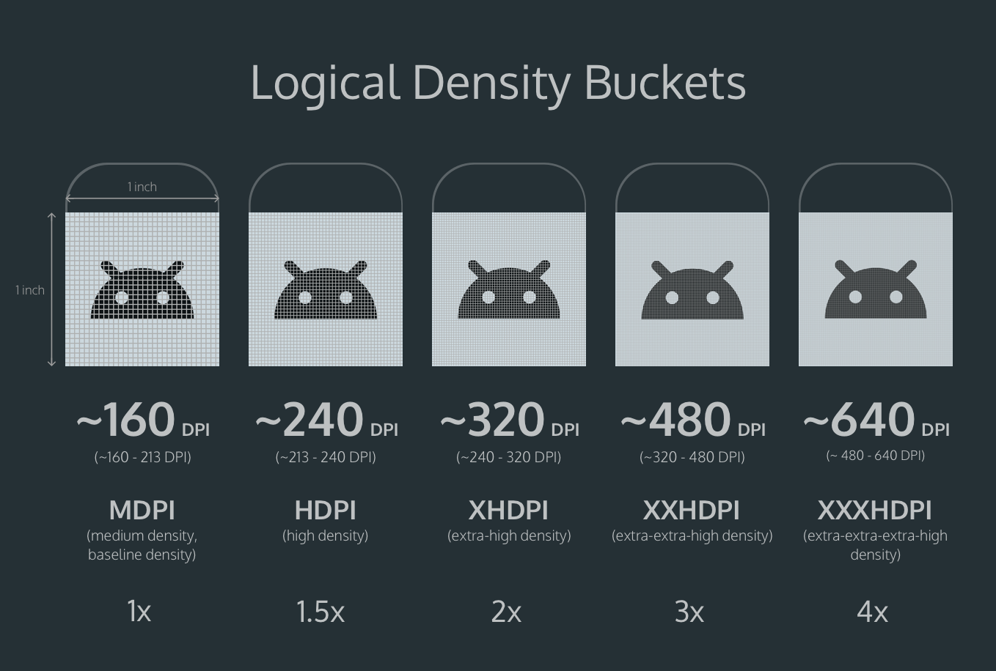
Understanding Dimensions
Notes:
https://blog.prototypr.io/designing-for-multiple-screen-densities-on-android-5fba8afe7ead
https://stackoverflow.com/questions/2025282/what-is-the-difference-between-px-dip-dp-and-sp

Slide 83
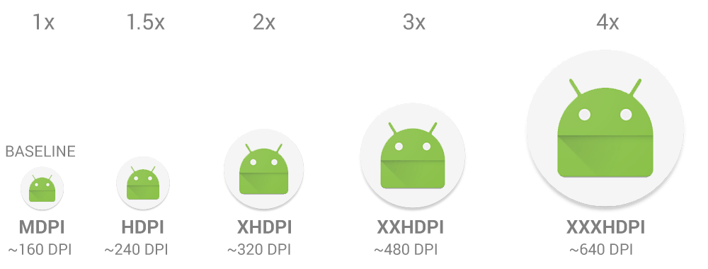
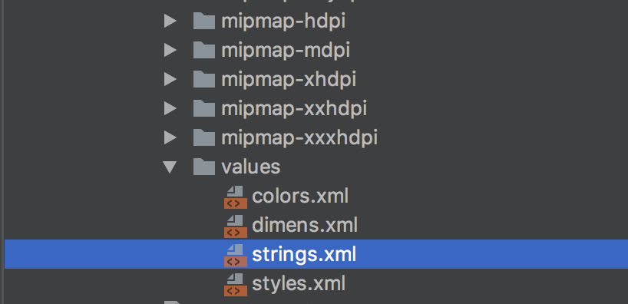
Understanding Dimensions
For JPG / PNG images, you should supply an image for each major density bucket. Otherwise, the system will have to scale what’s available.

Slide 84
Understanding Dimensions
SVGs (vector graphics) have limited support, but are great because they scale nicely (you only need to supply one version).

Slide 85
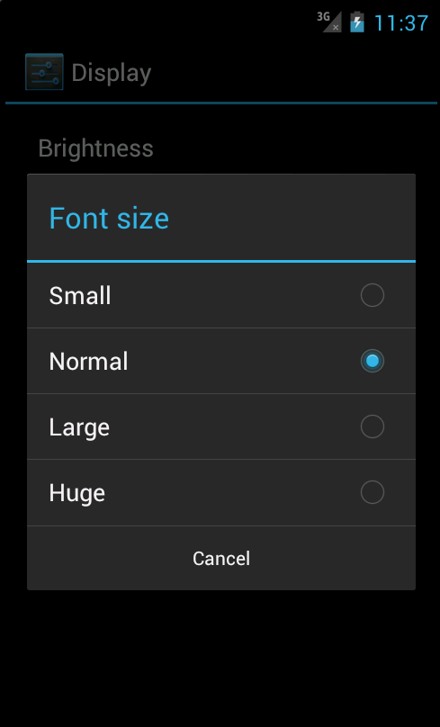
Understanding Dimensions
For text -- you should use sp for “scale-pixels”. This is similar to dp, but also respects the user’s system font size setting.

Slide 86
LinearLayout
Let’s see a quick example of building the same screen using a LinearLayout - it would be perfectly reasonable to use it here instead of a ConstraintLayout.

Slide 87
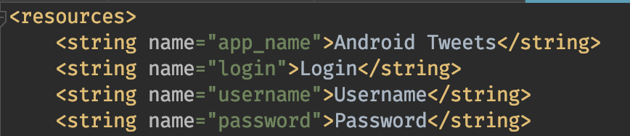
Resource Files
Android recommends you also specify strings, colors, and commonly use dimensions in XML, instead of hardcoding values.

Slide 88
Resource Files
Why?

Slide 89
Resource Files
Why?
Easier to maintain.

Slide 90
Resource Files
Why?
Easier to maintain.
More importantly, Android can select at runtime the correct resources depending on device configuration.

Slide 91
Resource Files
Why?
Easier to maintain.
More importantly, Android can select at runtime the correct resources depending on device configuration.
Language
Screen size
Screen orientation
Android version

Slide 92
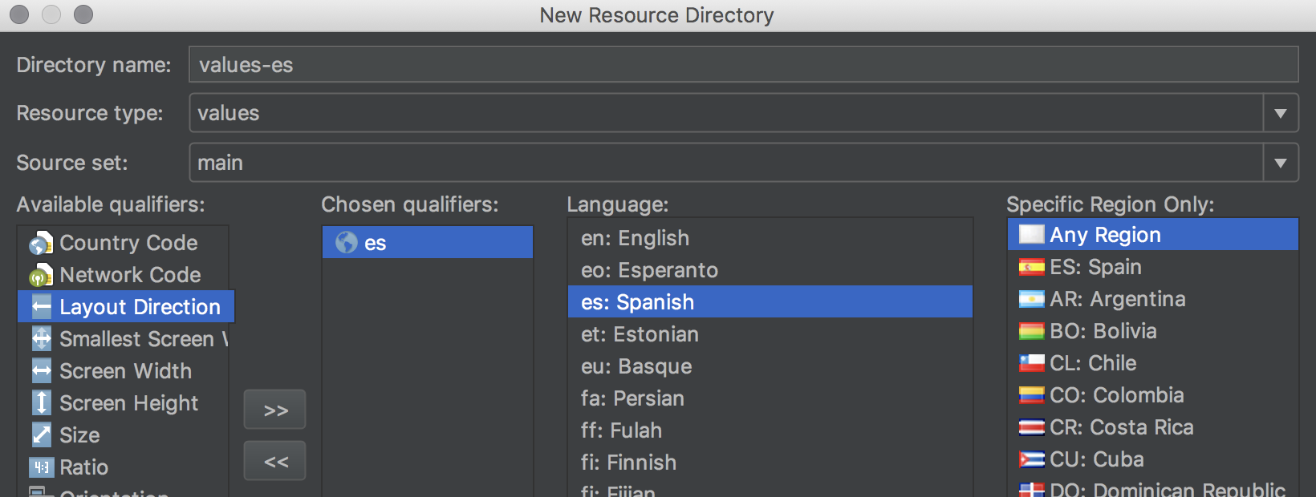
Resource Files
To add Spanish support, all we need is a values-es folder and another strings.xml file with Spanish strings in it.

Slide 93
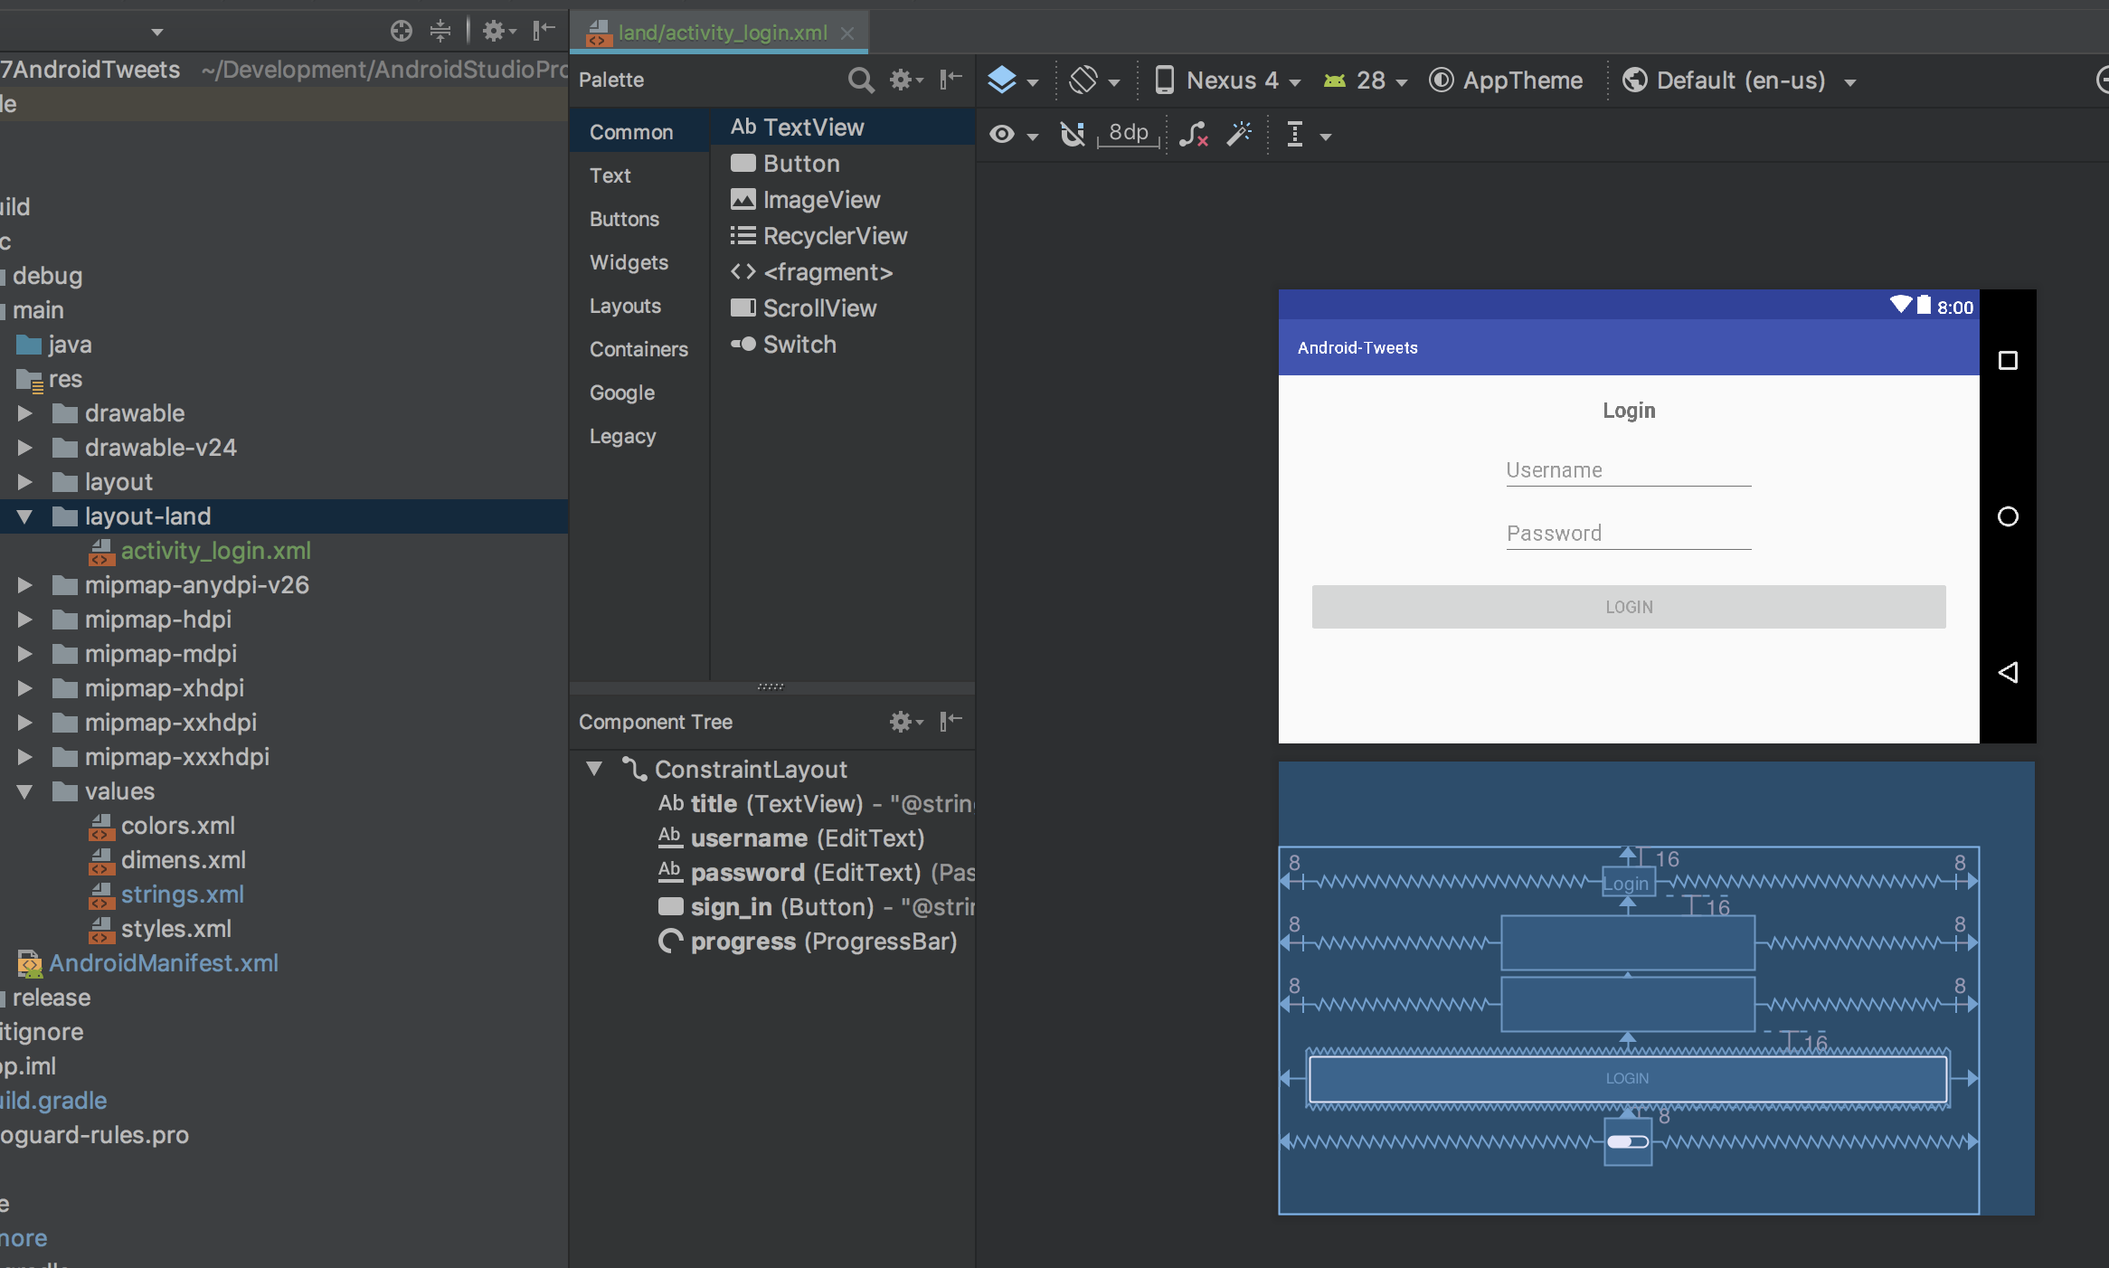
Resource Files
Or, to have a different layout for our login screen while in landscape mode, layout-land/activity_login.xml.

Slide 94
Rich ActivityBehavior

Slide 95
Login Activity
This section of lecture also has a set of step-by-step instructions: https://github.com/nickcapurso/SE-Summit-Android-Workshop/tree/master/instructions/3%20-%20Login%20Code
However it’s in Java, but it’s all the same concepts and a similar-looking screen.

Slide 96
Behavior Code goes in the Activity class
class MainActivity : AppCompatActivity() {
override fun onCreate(savedInstanceState: Bundle?) {
super.onCreate(savedInstanceState)
setContentView(R.layout.activity_login)
}
}
For each view we need to create a variable, set a value for it, set up any event-listeners.

